Slide 1
Learning From Synthetic Data: Addressing Domain Shift for Semantic Segmentation
https://arxiv.org/pdf/1711.06969.pdf

Slide 2
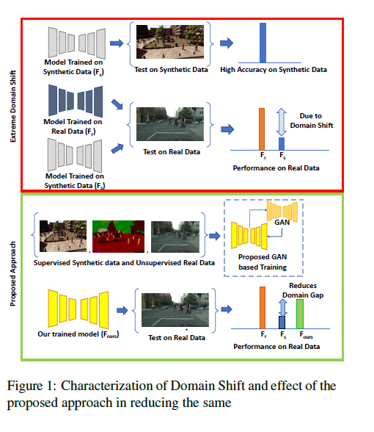
PROPOSED IDEA
Idea is to utilize synthetic images to address domain shift in semantic segmentation.
Reclines on adversarial framework for domain adaptation approach.
Focus of the paper is to develop domain adaptation algorithm for semantic segmentation.

Slide 3
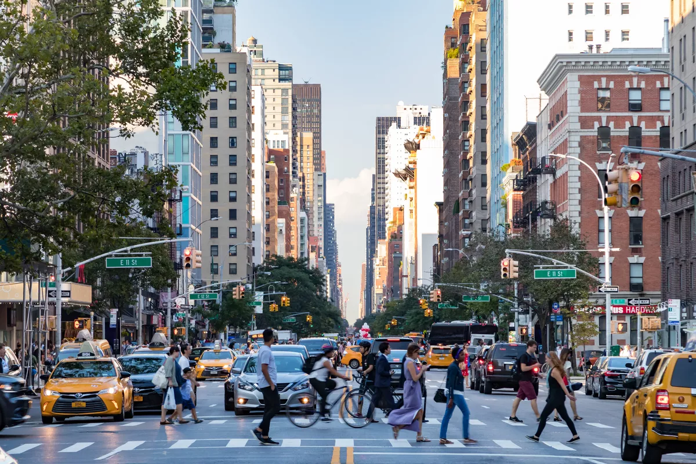
DOMAIN SHIFT – DOMAIN ADAPTATION
MODEL TEST ON PARIS STREETS
Build model (Self driving) to segment images based on car’s camera. Should predict what lies ahead.
Model trained on annotated NYC data set.
Test On Manhattan streets, model works fine.
Test model on Paris streets ,model fails.
REASON: DOMAIN SHIFT . This is the case where input data changed while task domain(labels) remained same.
SOLUTION: BUILD DOMAIN INVARIANT MODEL BY DOMAIN ADAPATATION APPROACH
MODEL TEST ON NYC STREETS

Slide 4
CHALLENGE IN SEMANTIC SEGMENTATION
Involves obtaining pixel level labels , resulting huge amount of human effort and time in annotating data
Resulting lack of labeled data for training.
Proposed approach that addresses the above issues is the utility of synthetically generated data for training and addresses domain shift problem as well

Slide 5
PROPOSED METHOD AND TECHNIQUE
Source dataset with labels and Target dataset without labels.
Unsupervised domain adaptation approach.
Make the network learn feature representation of input image and use that information to reconstruct same image.
Next impose domain alignment by forcing the network to learn features such that source features produce target like images when passed to the reconstruction module and vice-versa.

Slide 6
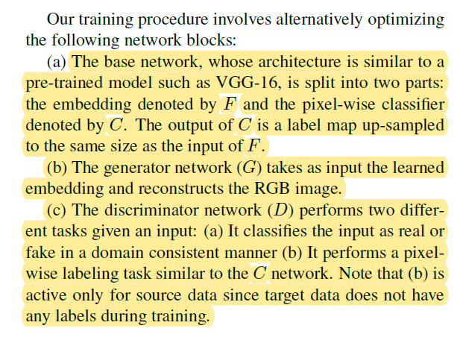
DISCRIPTION OF NETWORK

Slide 7
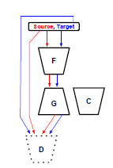
TREATMENT OF SOURCE AND TARGET DATA
Input source data with source image and label pair to network.
Input target data with target image to network.
During target input C network is not active.

Slide 8
ITERATIVE OPTIMIZATION
In each iteration randomly sampled (Xs; Y s;Xt) provided to the system. Then, the network blocks are updated iteratively in the following order:
1. D-update :
2. G –Update :
3. F-Update:

Slide 11
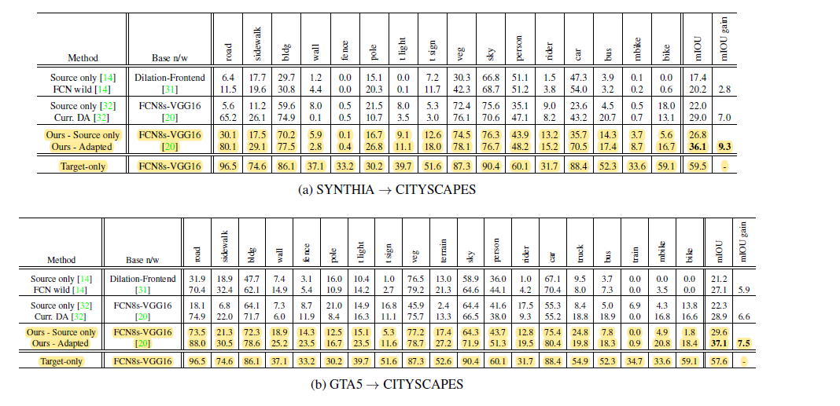
EXPERIMENTS AND RESULTS

Slide 12
CONCLUSION AND FUTURE WORK
Addressed the problem of performing semantic segmentation across different domain.
Proposed approach reclines on adversarial approach.
Transfers the information of target distribution to learned embedding using generator-discriminator pair.
Extend approach over temporal inputs such as videos across different domains.

